Slide 1
Digital Dive Log Signature System
By: Aaron Suchovsky and Vince Augustine

Slide 2
Project Purpose and Goal Statements
Purpose: To make an app that automates the outdated system of signing off on dive logs.
Goal Statements:
To design a highly efficient QR code scanner that will allow divemasters to sign off on dive logs in a faster, more efficient way.
Design an app that will replace an outdated system.
Allow divemasters to sign hundreds of dive logs in a matter of minutes.

Slide 3
Contact Information
Vince Augustine: 724-996-0946
augustvm@mail.uc.edu
Aj Suchovsky: 216-210-5365
suchovaj@mail.uc.edu

Slide 4
Abstract
The creation of the Digital Dive Log Signature System is important due to an outdated system that Scuba Divers use to track dives. The scuba divers use a dive log to track dives and a dive master must physically sign all the diver’s logs to verify that the diver went on the dive. With a lot of people and multiple dives, the dive master will have to sign a great deal of logs over a course of their time working. Our system will make the signing of the logs easier by the divers scanning the dive masters QR code that holds a digital signature and have it apply to the digital dive log.

Slide 5
User Stories
As a scuba diver, I would like to be able to speed up the time it takes my dive master to sign off on my last dive.
As a divemaster, It takes way too long to sign off on dives, I would love to have an easier and digitalized way to sign off on diver’s previous dives.
As a software developer and scuba diver, bringing scuba diving and software together will create a more efficient way of logging and signing off on dives.
As a software developer, I want to help digitalize and make anything more efficient and this a great way of helping divers and dive masters digitalize log books.

Slide 6
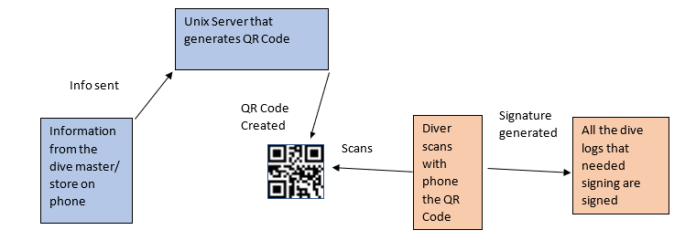
Design Diagram I

Slide 7
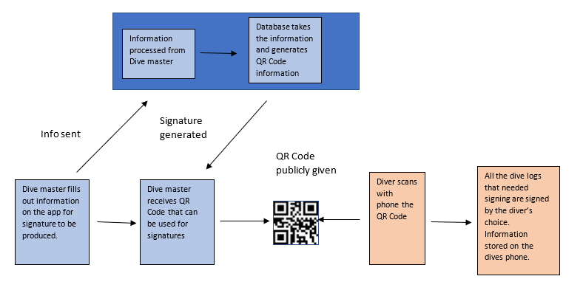
Design Diagram II

Slide 8
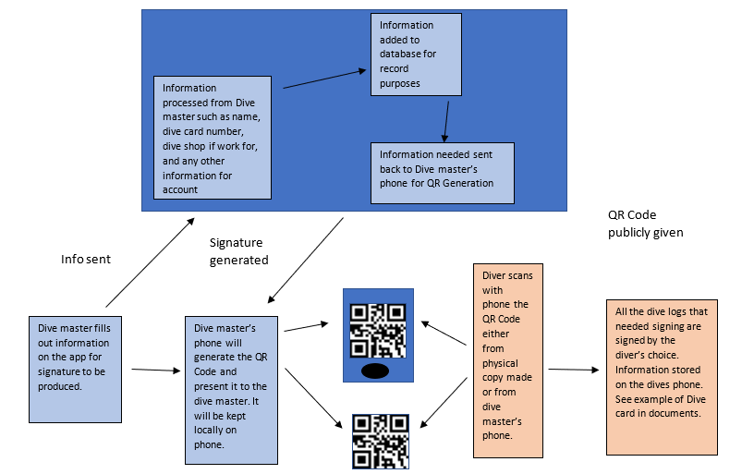
Design Diagram III

Slide 9
Milestones:
Milestones
1. All research gathered. This includes how and what to use for the database, refresh on how to use Android Studio, and how QR codes work. The deliverable for this is either in the form of notes or explanation of items that we used in our documents. This is a list of specific things either researched or decided on.
2. Start designing user interfaces and the SQL database. This will be in the form of how tables will interact with each other before coding the table so that we can link tables and have a visual representation of how this will look. Going in and making the SQL table without this could result in a lot of wasted time trying to fix issues. This goes with the interfaces as they will need to be designed before coded in order to reduce unforeseen issues that may arise in the design and transition from pages of the App.
3. Start coding the Database. The deliverable for this will be a fully functioning SQL database that can both send and receive information. This will be made with SQL and will have all parts from the design implemented.
4. Start coding Interface. This will take the longest and will need to be broken up further which is in the task list and Timeline. The deliverable for this will be actual code documents made and progression towards an actual App.

Slide 10
Milestones (cont.)
5. First prototype test. The deliverable for this will be the whole app and database doing the function of scanning a QR code and getting a response on the dive log. This will be the most basic form and will not have bells or whistles attached to it.
6. Second prototype test. This will be after all the bugs from the first prototype are taken care of as well as any bells and whistles that have been decided to add on. The main deliverable here is the App without the bugs from the first prototype test. Any additions are more icing on the cake.
7. Final Product with deliverable for senior design. The deliverable here will be everything we have previously done as well as a board to present in the Senior Design Fair. This will consist of the board and the third prototype or the second in a successful state.

Slide 11
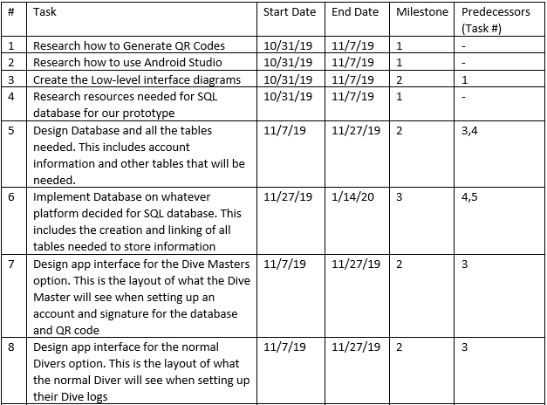
Timeline

Slide 12
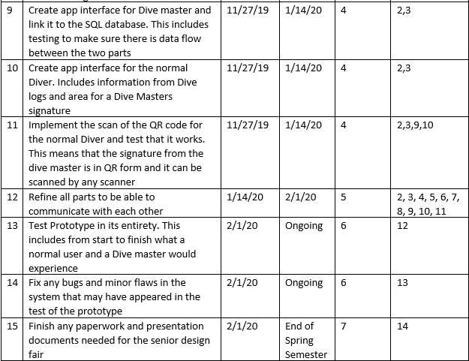
Timeline (cont.)

Slide 13
Project Constraints
There are constraints that will appear during the prototype build of our project. One major constraint is the security of the app. The divemaster’s signatures will have to be sent to the SQL database in a very secure manner. We will be able to use built in security software, however we will have to test the actual safety of this security firewall. Another constraint is making it used widely. Some people are not completely adapted to the technology era and maybe some divemaster’s will not change their normal ways of signing off on dives. This in turn will impact the success of our app. Even though the app will make it very easy to sign off on dive logs, some masters will not adapt themselves to the app. The third constraint we will have is professional. AJ and I have had a background in this area of app development, however it will be a very big challenge setting up a working SQL server and allowing these digital signatures to be passed from diver and divemaster. We will have to do an abundance of research on the app development side to make this a working prototype.

Slide 14
Current State of Project
We are in a research and planning phase of the project. After this presentation, coding will start and our prototype will be on it’s way. We will first focus on the sql database then the front end UI will be designed in collaboration of the database.

Slide 15
Expected Accomplishments
We expect our prototype to be near finished and testing has started. This will give us ample time to debug any issues in our app before any deadlines. All research, planning, and administration work will also be finished so we can focus our time solely on the app.

Slide 16
Who is doing what on the project?
AJ:
- SQL server setup and assistance with connecting the app to the server.
- project descriptions, milestones, diagrams, timeline.
Vince:
Constraints, user stories, Project Presentation.
Complete UI and app development. Assisting on SQL server setup and connection with the app.

Slide 17
Expected Demo at Expo
We expect a fully working app prototype that allows QR codes to be scanned and saved to a database. This in turn will allow the diver to receive a digitally signed dive log from the dive master. We will present the app and show the expo all of it’s working features.

Slide 18
Title
project purposes and goals statements (Vince)
Names
include all group member names, contact info, and project advisor (Vince)
Project Description
Project Abstract - carefully written statement of ~100 words, highlight key terms (AJ)
User Stories (Vince) and Design Diagrams (AJ) (assignment #4)
Project Constraints (assignment #7) (Vince)
Review of Project Progress
Current state of project (Vince)
Expected Accomplishments for the end of this term (Vince)
Timeline and Division of Work
Project Timeline and Milestone (AJ)
Who is doing what on the project (Vince)
Expected Demo at Expo (Vince & AJ)

